Slide 1

Minor Project Presentation on Artificial intelligence based medical image analysis for intracranial hAAemorrhage using cnn
Presented by: - Naksh kumar​(DS),
Ruchi Shukla(AI),
Shristi sahu(AI).

Slide 2
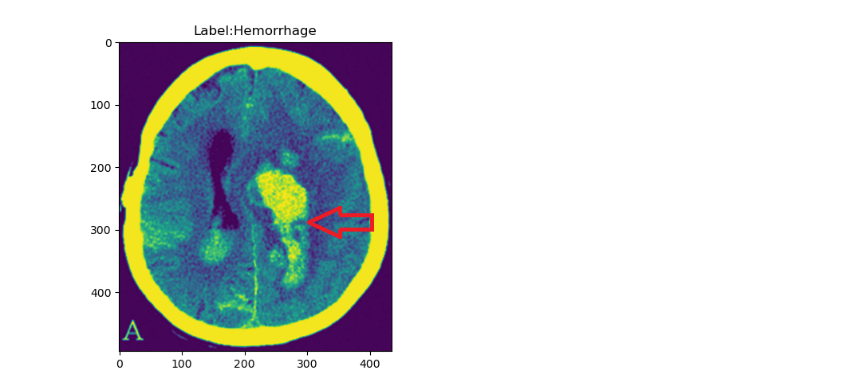
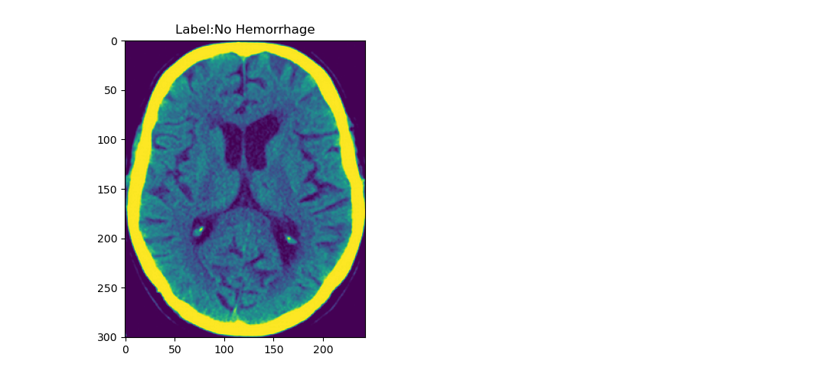
introduction
Problem statement of our project is “Artificial intelligence based medical image analysis for Intracranial Hemorrhage using CNN”.

Slide 3
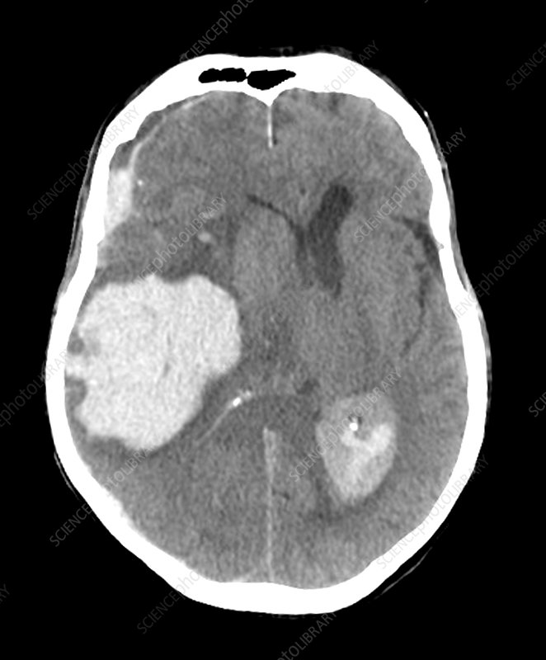
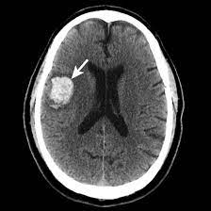
RESEARCH indicates that most experienced physicians can diagnose intracranial hemorrhage with knn(72.5 % accuracy), svm(65% accuracy) or random forest (77.50% accuracy) these diagnosis is achieved using machine learning techniques. our task is to detect intracranial hemorrhage at an early stage using CNN and more accurate.

Slide 4
WORK Flow
Start
Load Data
Split Data
Build Model
Generate
Data Batches
Data Augmentation
Train Model
Compile Model
Display Prediction
Evaluate Model
End

Slide 5
REQUIREMENTS:
Python 3.9.18
Pandas(pip install pandas).
Numpy( pip install numpy == 1.21.2).
Opencv(pip install opencv).
Sciket-learn(pip install sciket-learn).
Scipy (pip install scipy).
Glob(pip install glob).
Tensorflow (pip install tensorflow).
Keras(pip install keras).
Dataset of CT (Computed Tomography) 200 images with csv labels(100 hemorrage and 100 normal ).

Slide 6
THANK YOU

